Slide 1
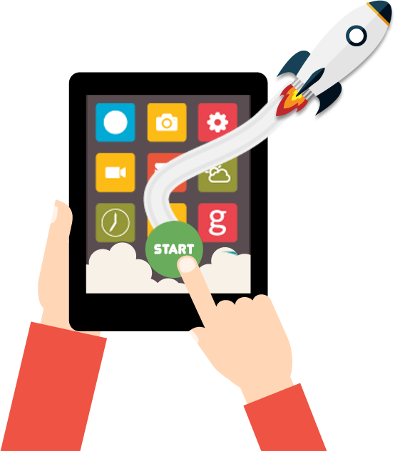
Webinar - How to Create a Killer Launch Plan for Your App
By
Raja Manoharan
Head – Mobile Marketing at Dot Com Infoway

Slide 2
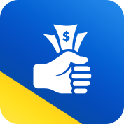
Dot Com Infoway Credentials
DCI was established in 2000
100+ IT professionals across 3 offices in 2 cities in India
Headquartered at Chennai, India
Other Initiatives
Cash On Apps
Notes:
2
2
2

Slide 3
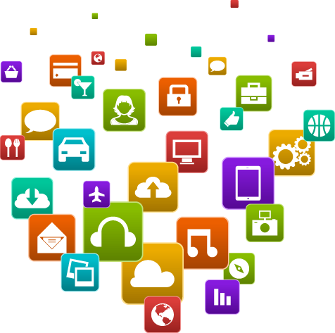
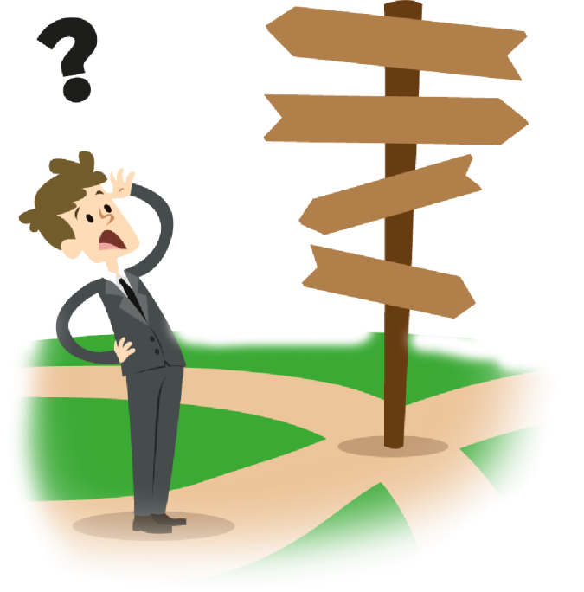
Housekeeping Instructions
All phones are set to mute. If you have any questions, please type them in the Chat window located beside the presentation panel.
We have already received several questions from the registrants, which will be answered by the speakers during the Q & A session.
We will continue to collect more questions during the session as we receive and will try to answer them during today’s session.
In case if you do not receive answers to your question today, you will certainly receive answers via email shortly.
Thanks for your participation and enjoy the session!

Slide 4
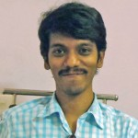
Speaker Profile
Having 9 years of hands-on Internet and mobile marketing experience, Raja has helped in promoting 100s of mobile apps for app developers across the globe.
His expertise lies in helping developers and clients understand the target market and in creating a holistic approach to app marketing, right from the pre-launch buzz to user acquisition and engagement.
He strongly believes in an integrated marketing communication model to achieve success in every single project he handles.
Mr. Raja Manoharan
Head – Mobile Marketing at Dot Com Infoway
Email ID: raja@dci.in

Slide 5
How To Create A Killer launch plan For Your App
Getting ready to launch a new app? No matter how great it is, in today's cluttered app stores, it probably won't speak for itself. The success of an app will often depend on the approach to marketing. Unfortunately the vast majority of app developers have little to no experience or marketing or managing a marketing budget.

Slide 6
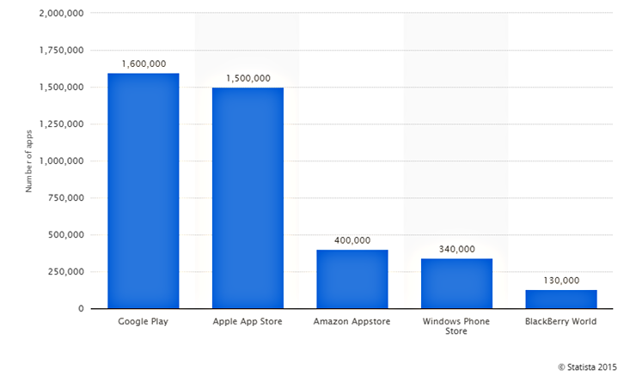
Number of apps available in leading app stores as of July 2015
This statistic contains data on number of apps available for download in leading app stores as of July 2015. As of that month, android users were able to choose between 1.6 million apps. Apple’s App store remained the second-largest app store with 1.5 million available apps.

Slide 7
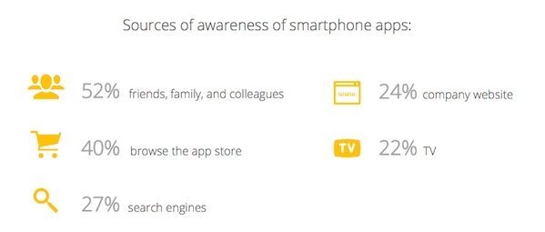
Facts
Price -82%
Description: 62%
Reviews: 60%
Rating: 60%
Free Trial: 43%
Source: ThinkwithGoogle.com
An average App user has 36 Apps installed in their Smartphone.
26% Smartphone Apps are used daily.
Gaming and Social are category Apps fall into daily used Apps
68% daily used apps are from Social & Communication
33% are from media and communication
75% users expect an App should be free
46% Game related apps
19% Retail store related

Slide 8
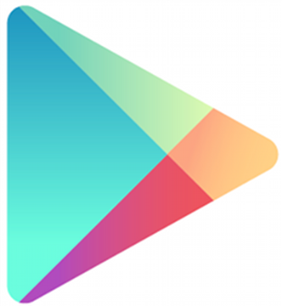
Current State Of App Stores
21% of Apps on iOS are dead according to Tech Crunch on the 6th Anniversary of the Apple App Store
Moz Research suggests out of 100 downloads, only 4 users stick around for a while
iOS App Store
According to a 2013 BBC report, 60% of apps have never been downloaded even once
According to Fisku, the average cost per app install is $1.28 and $1.78 for user retention.
According to GigaOM the top 1.6% make over $500,000 per month, while 35% of iOS developers and 49% of Android developers make less than $100 per month.
Google Playstore

Slide 9
The Math of App Business
Installs
Monthly Retention %
Monthly
Active Users
Monthly
Active Users
Monthly Avg. Revenue/user
Revenue

Slide 10
App Launch Marketing Plan
WHEN SHOULD YOU GET STARTED WITH THE MARKETING?
Early Launch Tactics
Prelaunch Tactics
Post Launch Tactics

Slide 11
Pre-Launch Marketing
Evaluate the App Concept itself
Evaluate the market
Research the competition
Identify Target Audiences
Create Messaging and Document Unique Differentiators
Create a crystal clear User journey

Slide 12
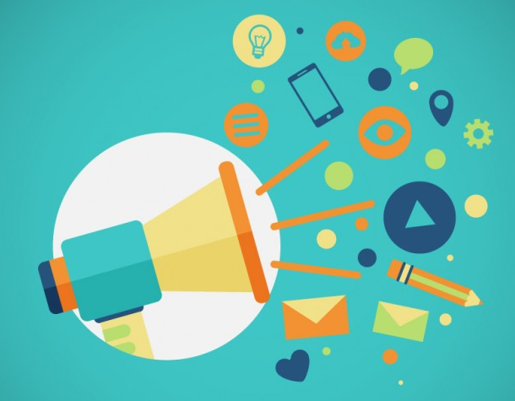
Early Launch Marketing
Start promoting early
ASO
App Name - Keywords
App Icon- Description
Screenshots
Preview Video
Teasers/Pre-launch trials
Beta Testing/Expert reviews
Analytics Setup & KPI Tracking
Press/Media Kit
Social Media and Other Accounts Setup
Building the Media list

Slide 13
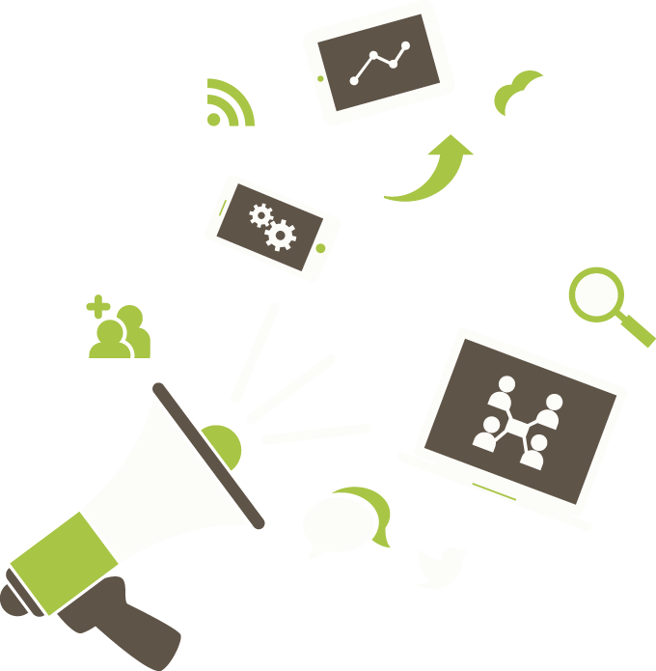
Post Launch Marketing
PR Activities & Blogger Outreach
UA campaigns
Social Media Promotions
Viral Marketing
Re-marketing
User Engagement & Customer Support
Contest & Giveaways

Slide 14
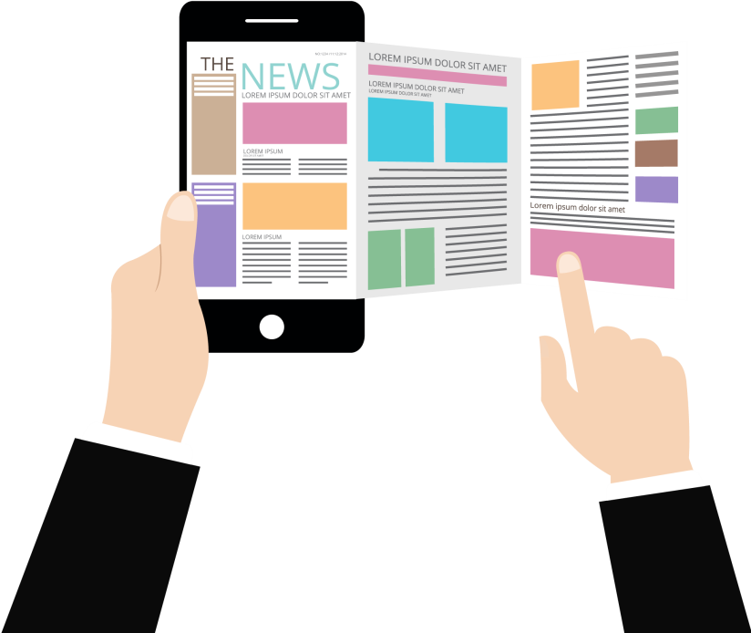
PR Activities
Unique app positioning
Identify key journalists
Pre-launch app build for press
Distributing Press Releases
Niche Bloggers
Forum Marketing
Set up Interviews
YouTube Video Reviews

Slide 15
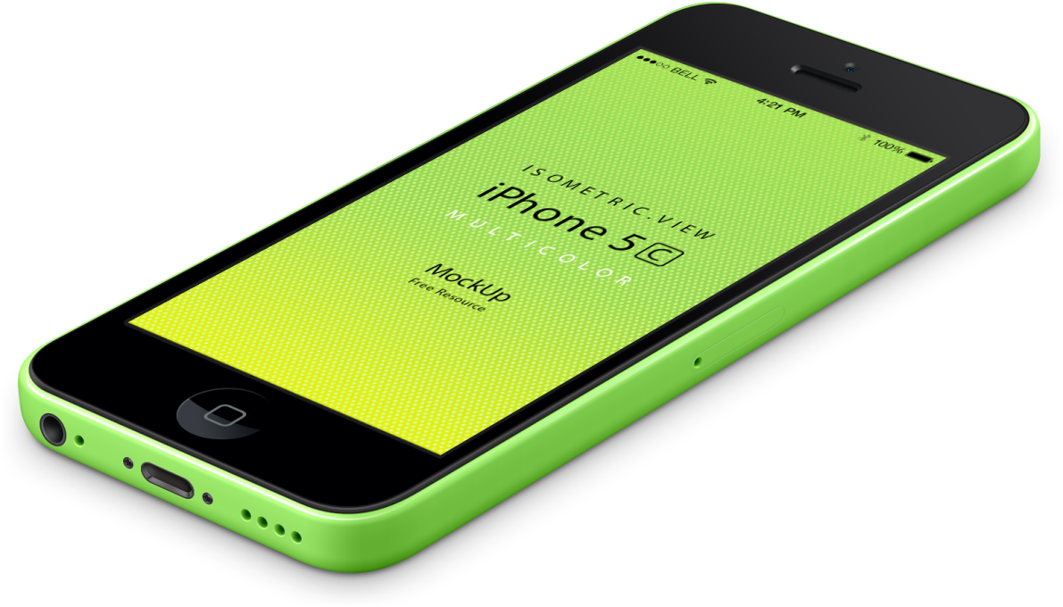
Best Practices for Organic Mobile
Optimization and Experimentation
ASO, PR activities, Social Media promotions constitutes the most important part of the organic app marketing.
Attribute and measure app installs
Identify campaigns and channels having the highest growth potential to acquire quality users. ( Eg : SMS, Email, Mobile Web and Social Media).
Optimize by designing experiments that focus on one aspect of the user lifecycle at a time, such as activation, retention or conversion.
Learn and Iterate

Slide 16
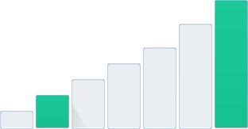
ASO – Rightly Done
App store optimization (ASO) is your best bet to gain low-cost app exposure, resulting in boosted app downloads, a higher number of quality users, and increased revenue.
ASO
App store optimization
General app store browsing is the most common way apps are discovered, up to 53% actually. With that said, you are up against over 1.5 million apps in both the Apple App Store and the Google Play Store.

Slide 17
ASO Tools
Search Man
Sensor Tower
App Annie
MobiledevHQ
AppFigures
Mobile Action
AppCodes
MetricsCat
Straply
Ensure your keywords are in the title
Use keywords in your app store description
Appealing Preview Video and screenshots
Better icon design to improve CTR
Seek to get reviews naturally
Seek to get people sharing and linking to your app store listings

Slide 18
User acquisition is getting harder,
not easier !
Finding the right users is critical to
whether an app lives or dies
– Fail and you’ll die.
Challenges in
User Acquisition

Slide 19
User Acquisition Funnel
Find out the App exists
Visit the App Store page
Decide to Download
Open the App for the First Time
Use the App on a Regular Basis

Slide 20
User Acquisition Channels
Incentivized CPI
Non-Incentivized CPI
Mobile App Wall
App of the Day Promotions
Social Media (Facebook, Twitter, Youtube Advertising)
Search Marketing (Google Adwords)
Television Advertising
Celebrity Features & Endorsements

Slide 21
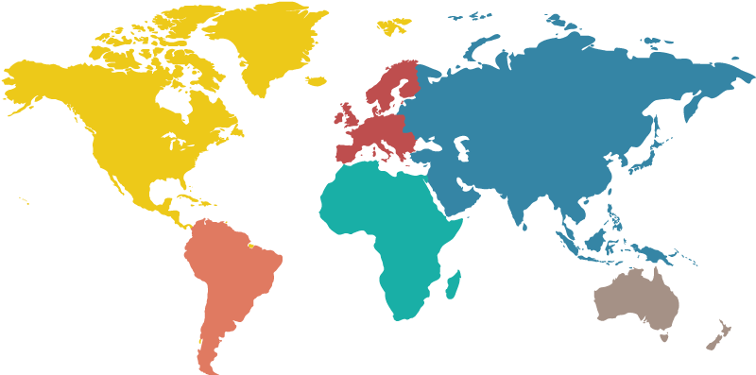
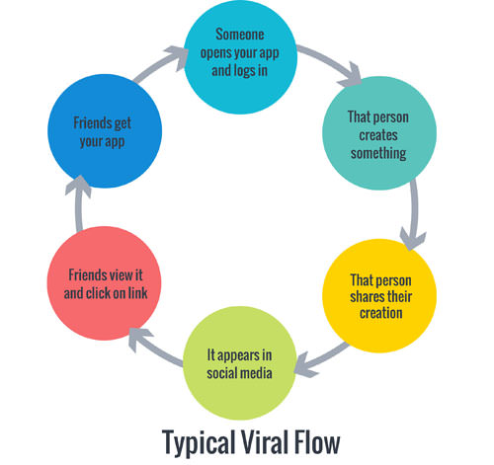
Viral Marketing
Does my app offer something valuable to share?
Is it worth being shared?
How will users be rewarded when they share?
Why will users want to share?
Why would they want their friends to share?
How will my app motivate users to keep sharing over the long term?

Slide 22
Remarketing
Drive more conversions from existing customers
Leverage your “power users” for upsells
Re-engage lapsed users

Slide 23
Social Media for User Acquisition
Think of social media as the modern form of “word of mouth marketing”. People are talking about your brand on social media, whether you’re listening and engaging or not.
Create targeted, shareable content.
Use social media channels to build a fan base
Close the loop with the “one click rule” of selling more apps
Reward users for connecting with your product
Embrace and encourage user-generated content

Slide 24
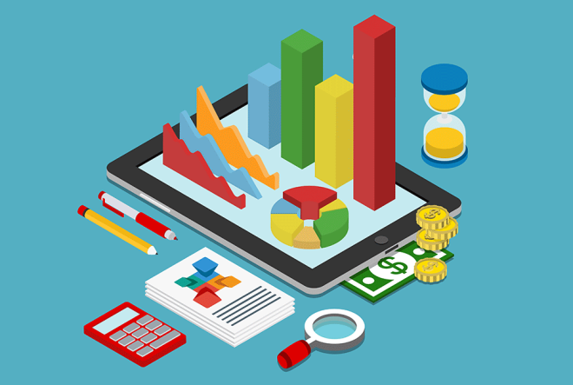
Best Practices
ACQUISITION:
This category covers all the metrics used to acquire users. Here are the most critical ones:
Downloads
New users
Active Users
ENGAGEMENT:
This category covers metrics that will tell you what percentage of users stick with your app after Downloading
Retention
Drop off rates
Session length
OUTCOMES:
Outcomes are the areas where users convert in your app.
In-app purchases
App purchases
Goal conversions (sign ups, view a certain screen, etc.)
App monetization
Determining the LTV of the user

Slide 25
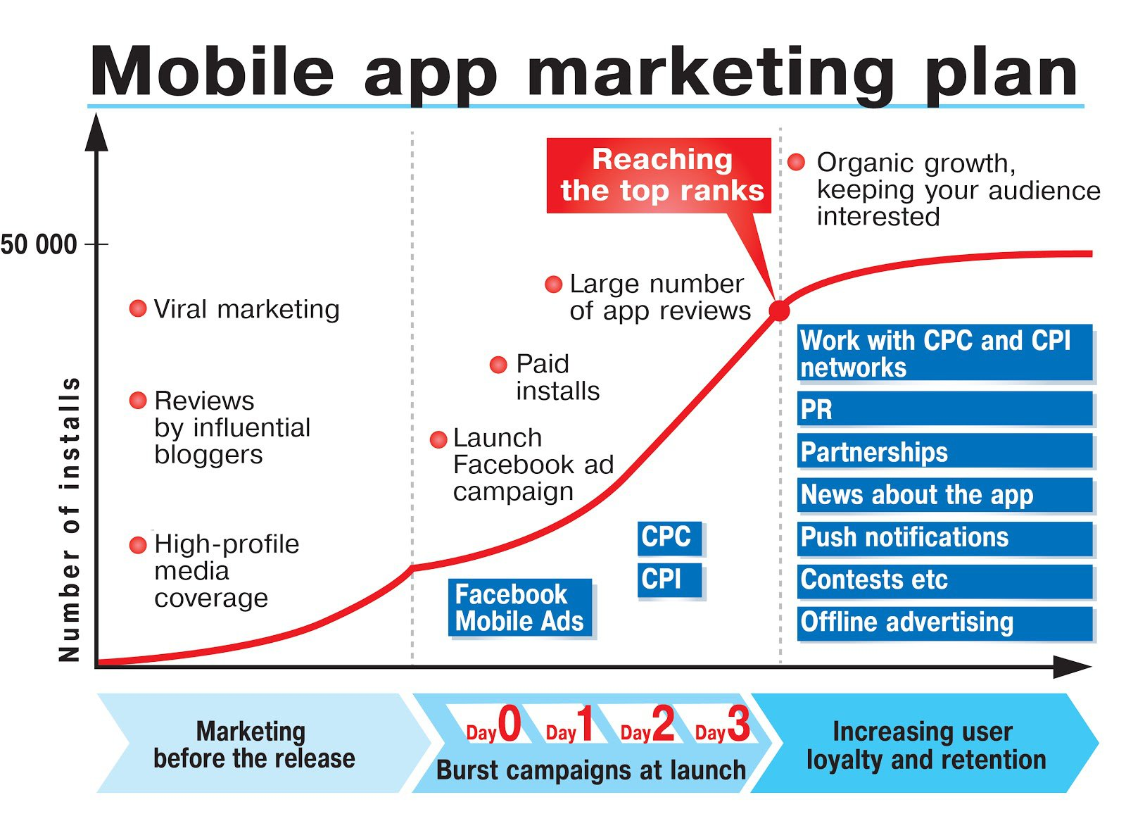
Source: Smartinsights.com

Slide 26
Key Take Aways
Building the right app and building it right
Optimizing your app store page
Choosing the right promo campaigns
Building an online presence
Finding what makes users come back to the app
Brand building around an app
Increasing app visibility and downloads
Engaging people and generating interest

Slide 27
Contact Us Today
Presenter:
Mr.Raja Manoharan
Email ID: raja@dci.in
Organiser:
Mr.Karthikeyan
Email ID: karthikeyan.vazhavandan@dci.in
www.facebook.com/DotComInfoway
www.twitter.com/dotcominfoway
www.linkedin.com/company/dotcominfoway
https://plus.google.com/+Dotcominfoway
www.dotcominfoway.com

